Slide 1

Notes:
Plane flying through

Slide 2


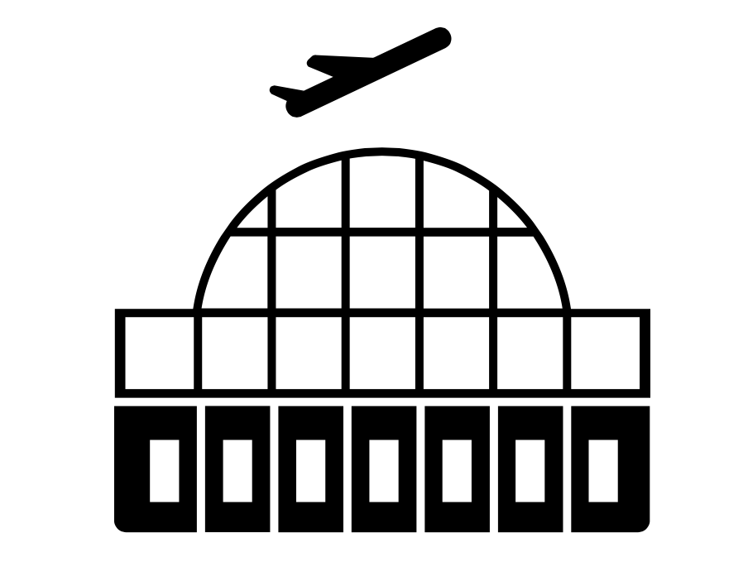


CHICAGO
NEW YORK CITY

Slide 3
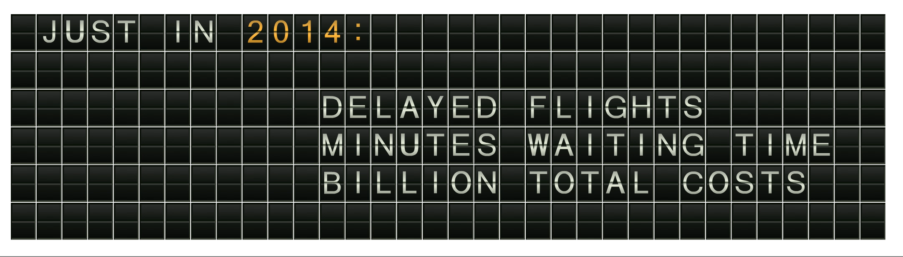





Notes:
Delayed Animation

Slide 4












AIRPORT
AIRLINE
WEATHER
TRAFFIC
REPAIRS
Why is my flight delayed?

Slide 5
AIRPORT
AIRLINE
WEATHER
TRAFFIC
REPAIRS
Why is my flight delayed?

Slide 6
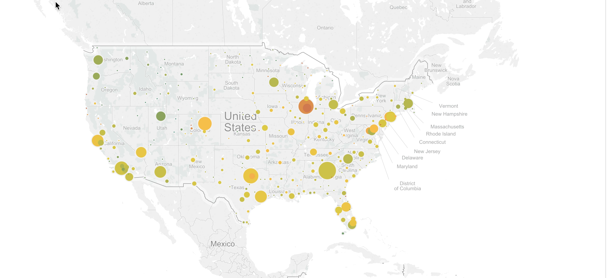

Slide 7
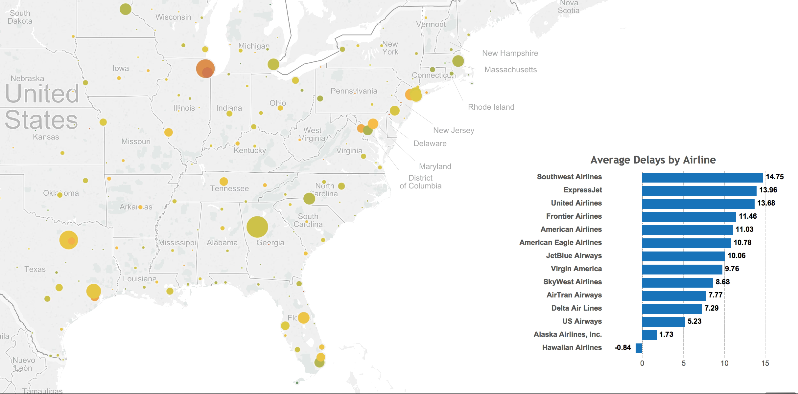

Slide 8

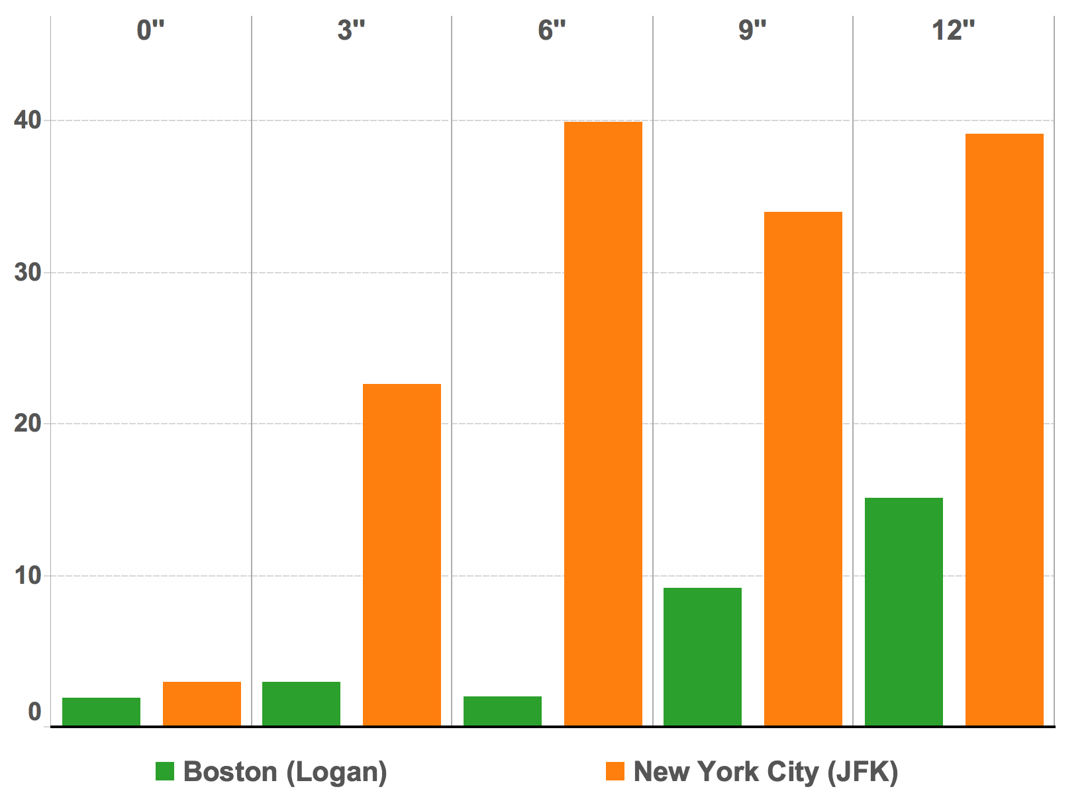


Delays and Snow
Depth (in Inches)
Avg.
Weather Delay
(in minutes)

Slide 9
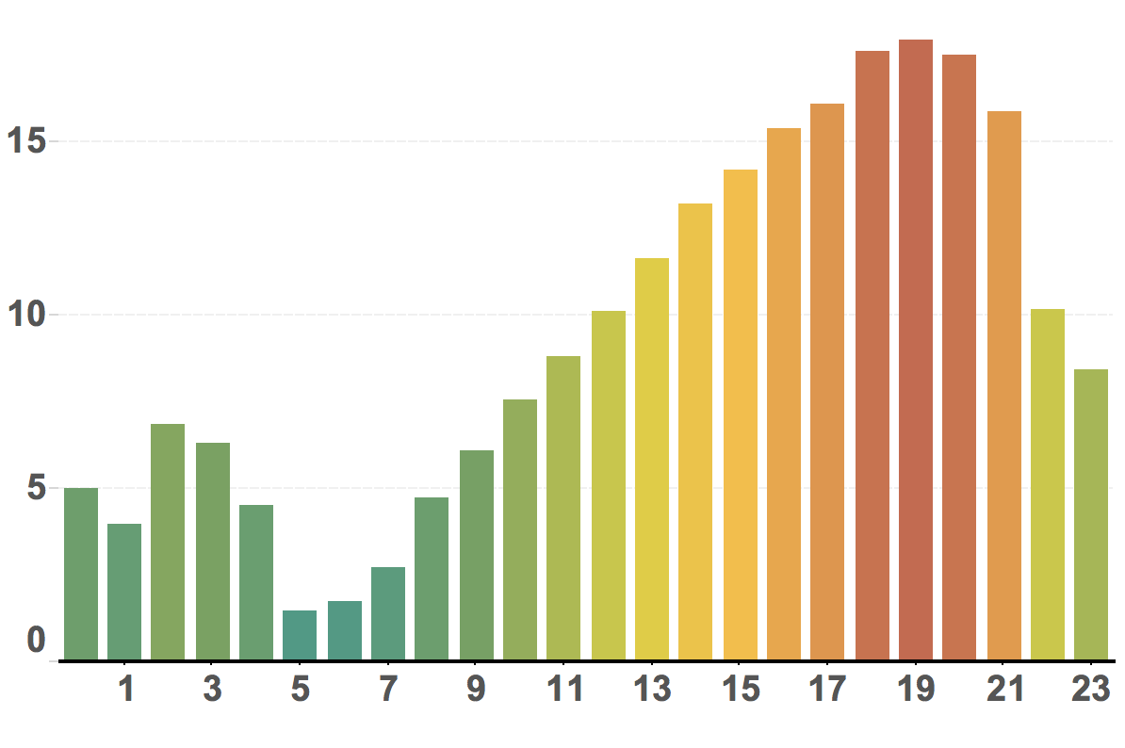
Avg. Delays per Time of Day
Avg.
Flight Delay
(in minutes)
Time of Day

Slide 10


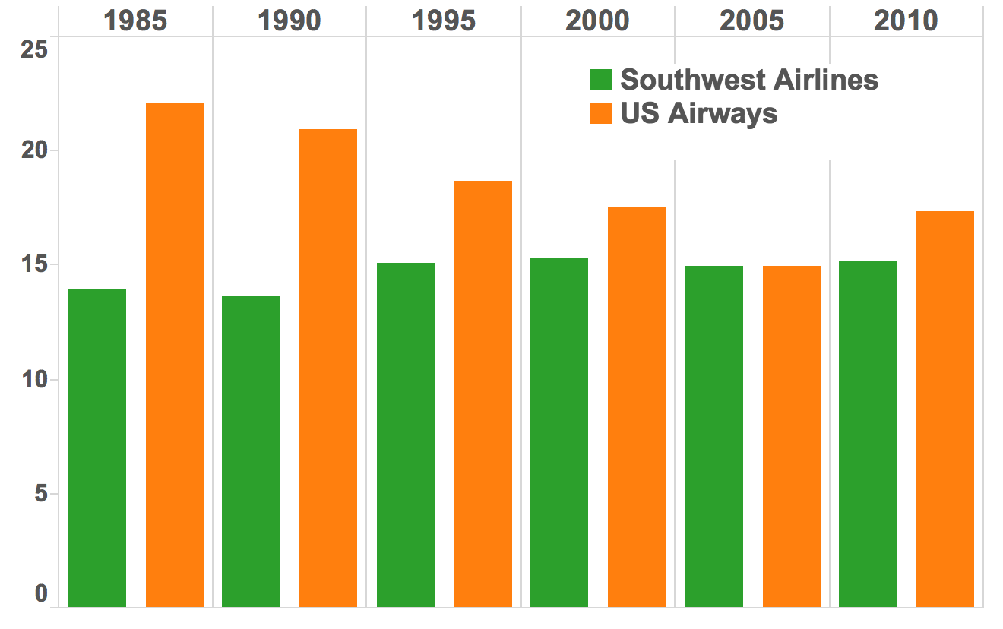
Aircraft Age
Average
Carrier Delay
(in minutes)

Slide 11
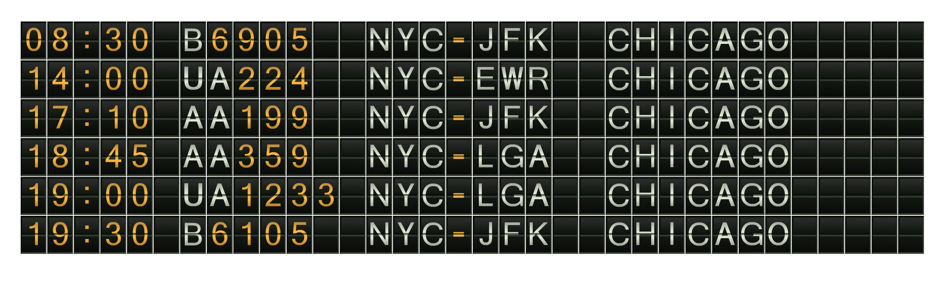


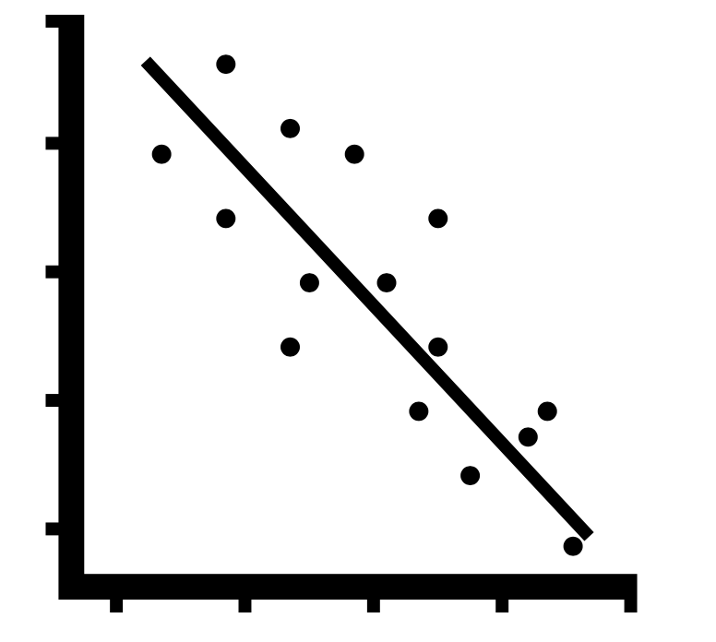
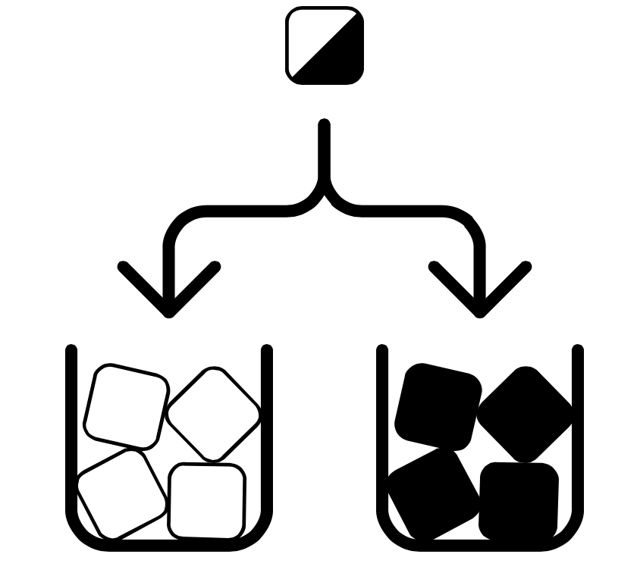
TIME
CODE
ORIGIN
DESTINATION
PRED.
22
Dec
Which flight should I choose?

Slide 12




